Slide 1


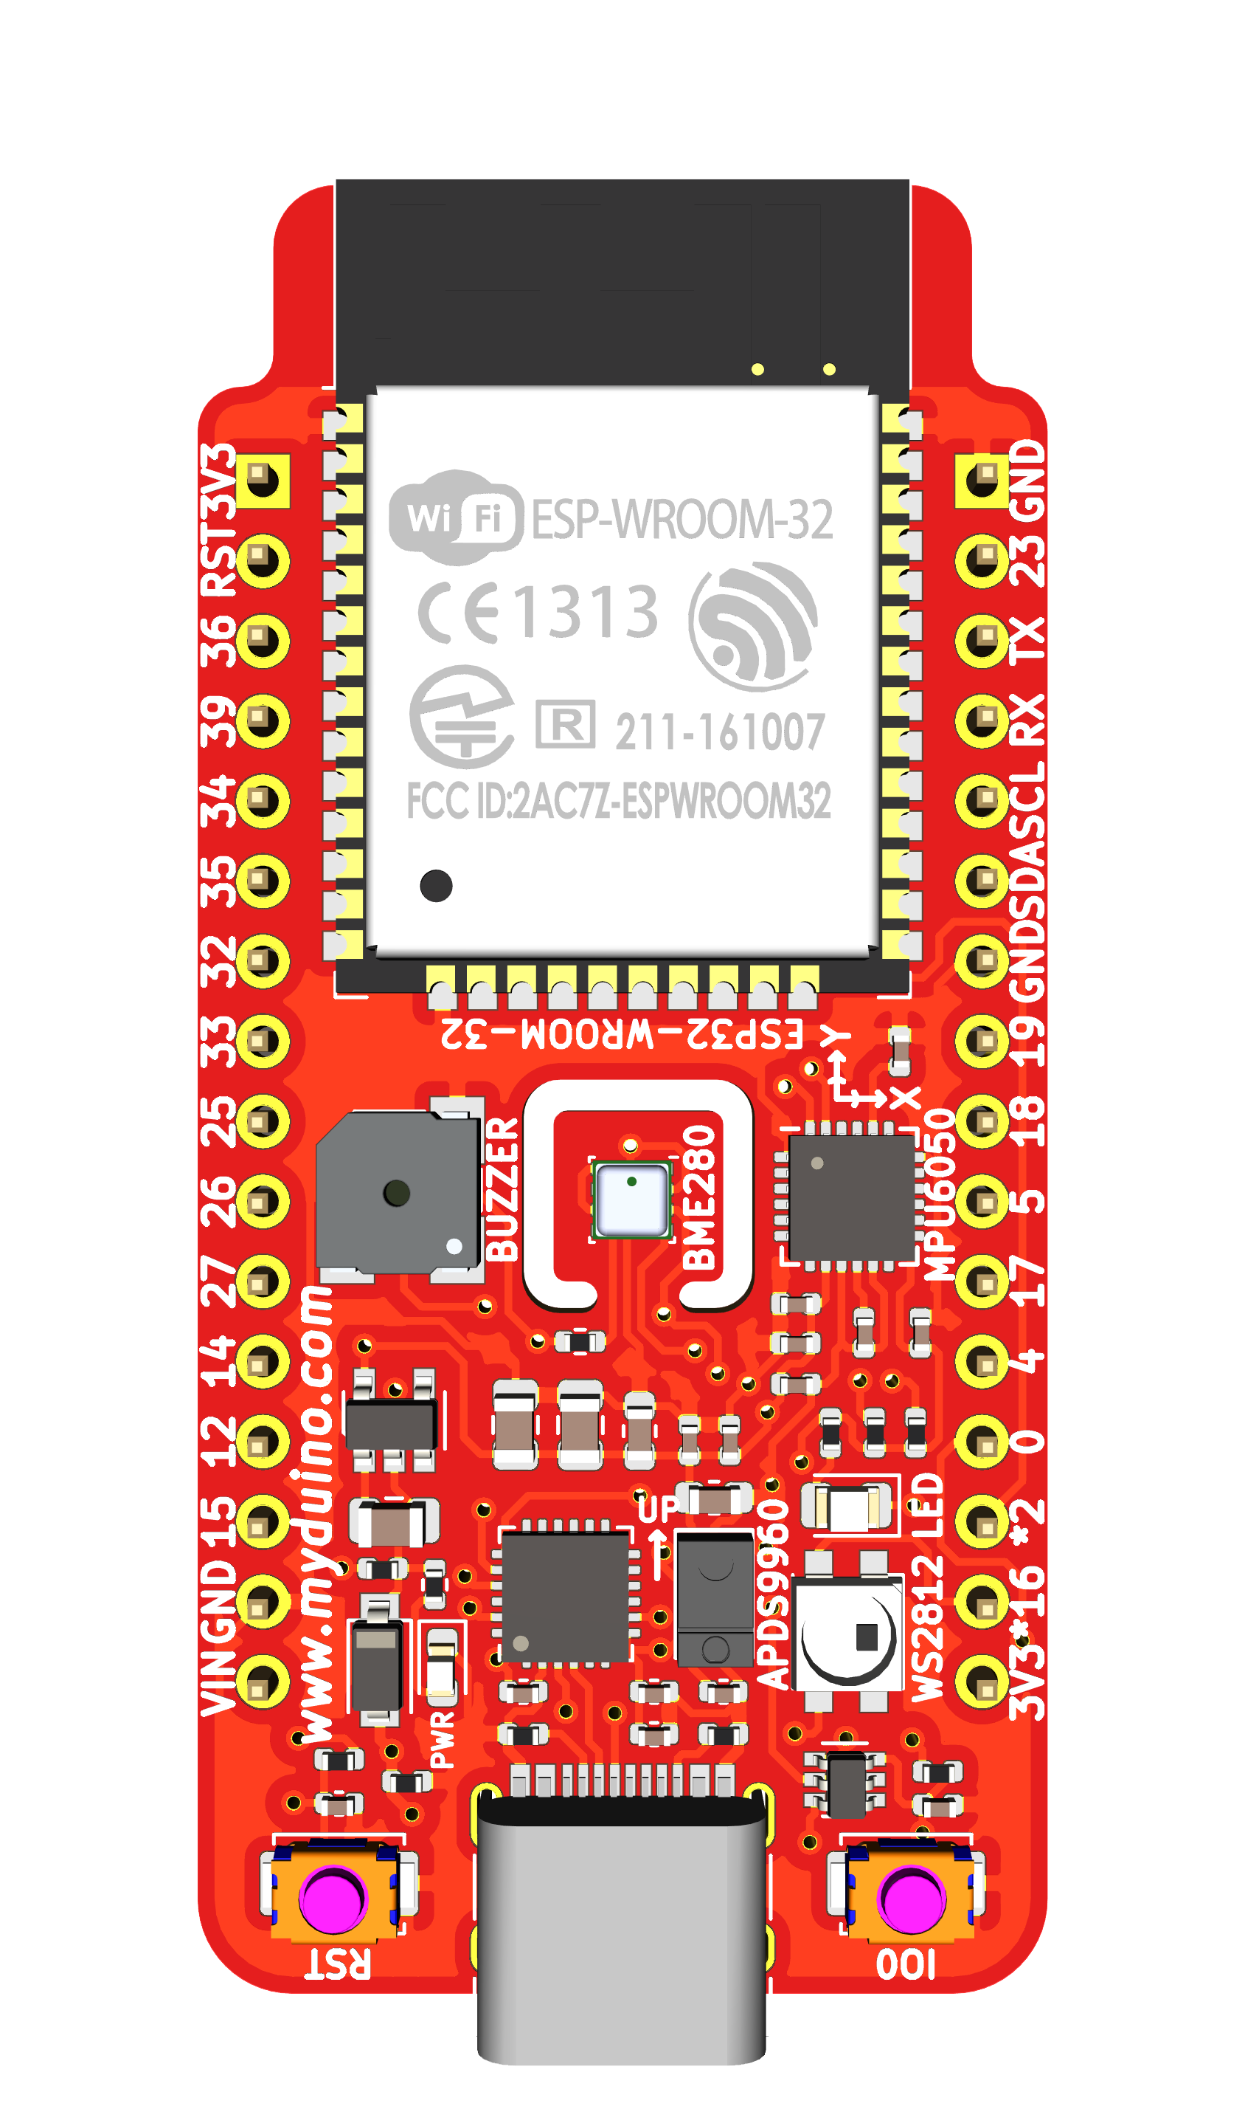

Slide 2
ESP32 SETUP

Slide 3
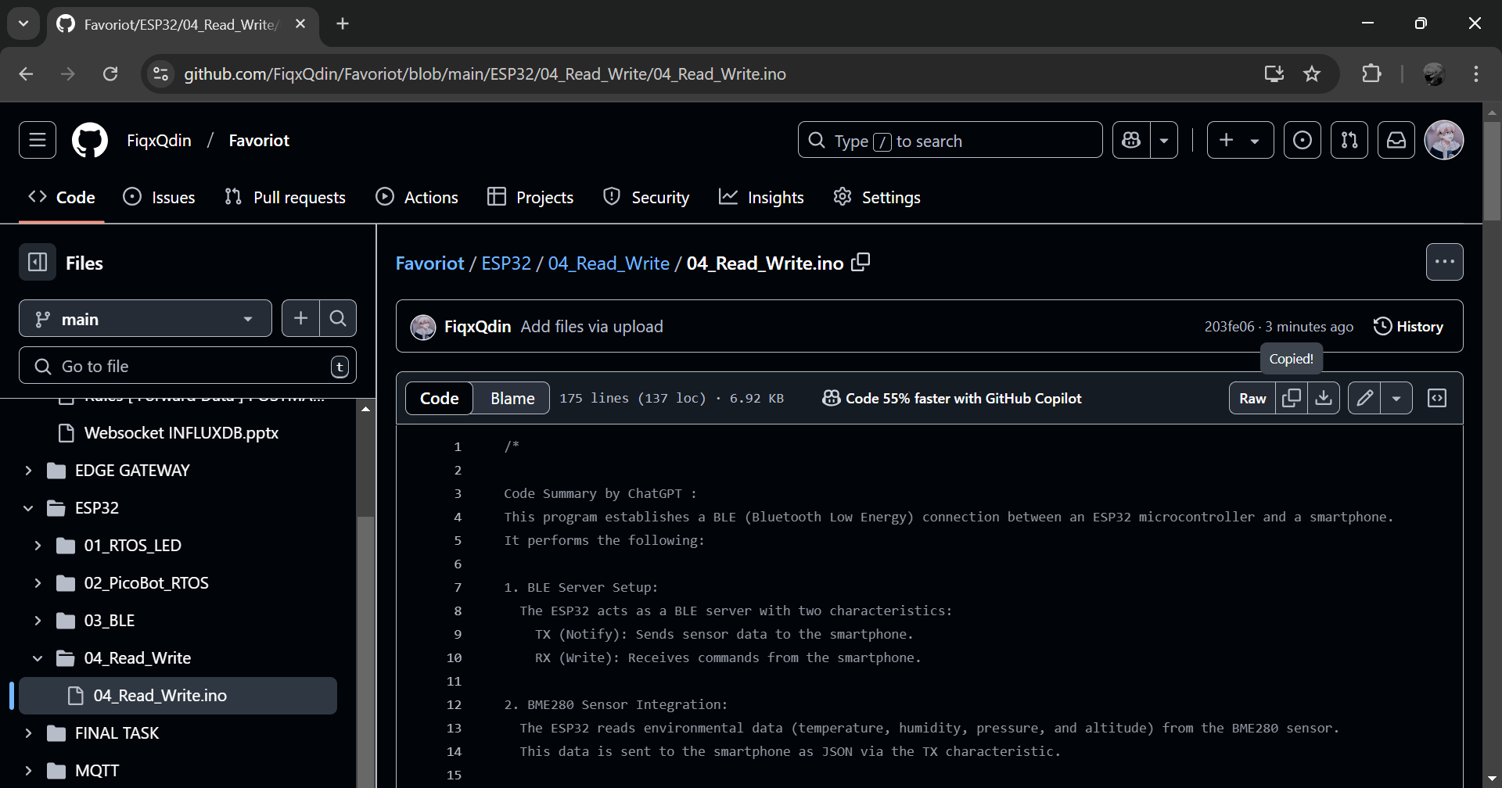
1
Copy the code from GITHUB
[https://github.com/FiqxQdin/Favoriot/blob/main/ESP32/03_BLE/04_Read_Write/04_Read_Write.ino].

Slide 4
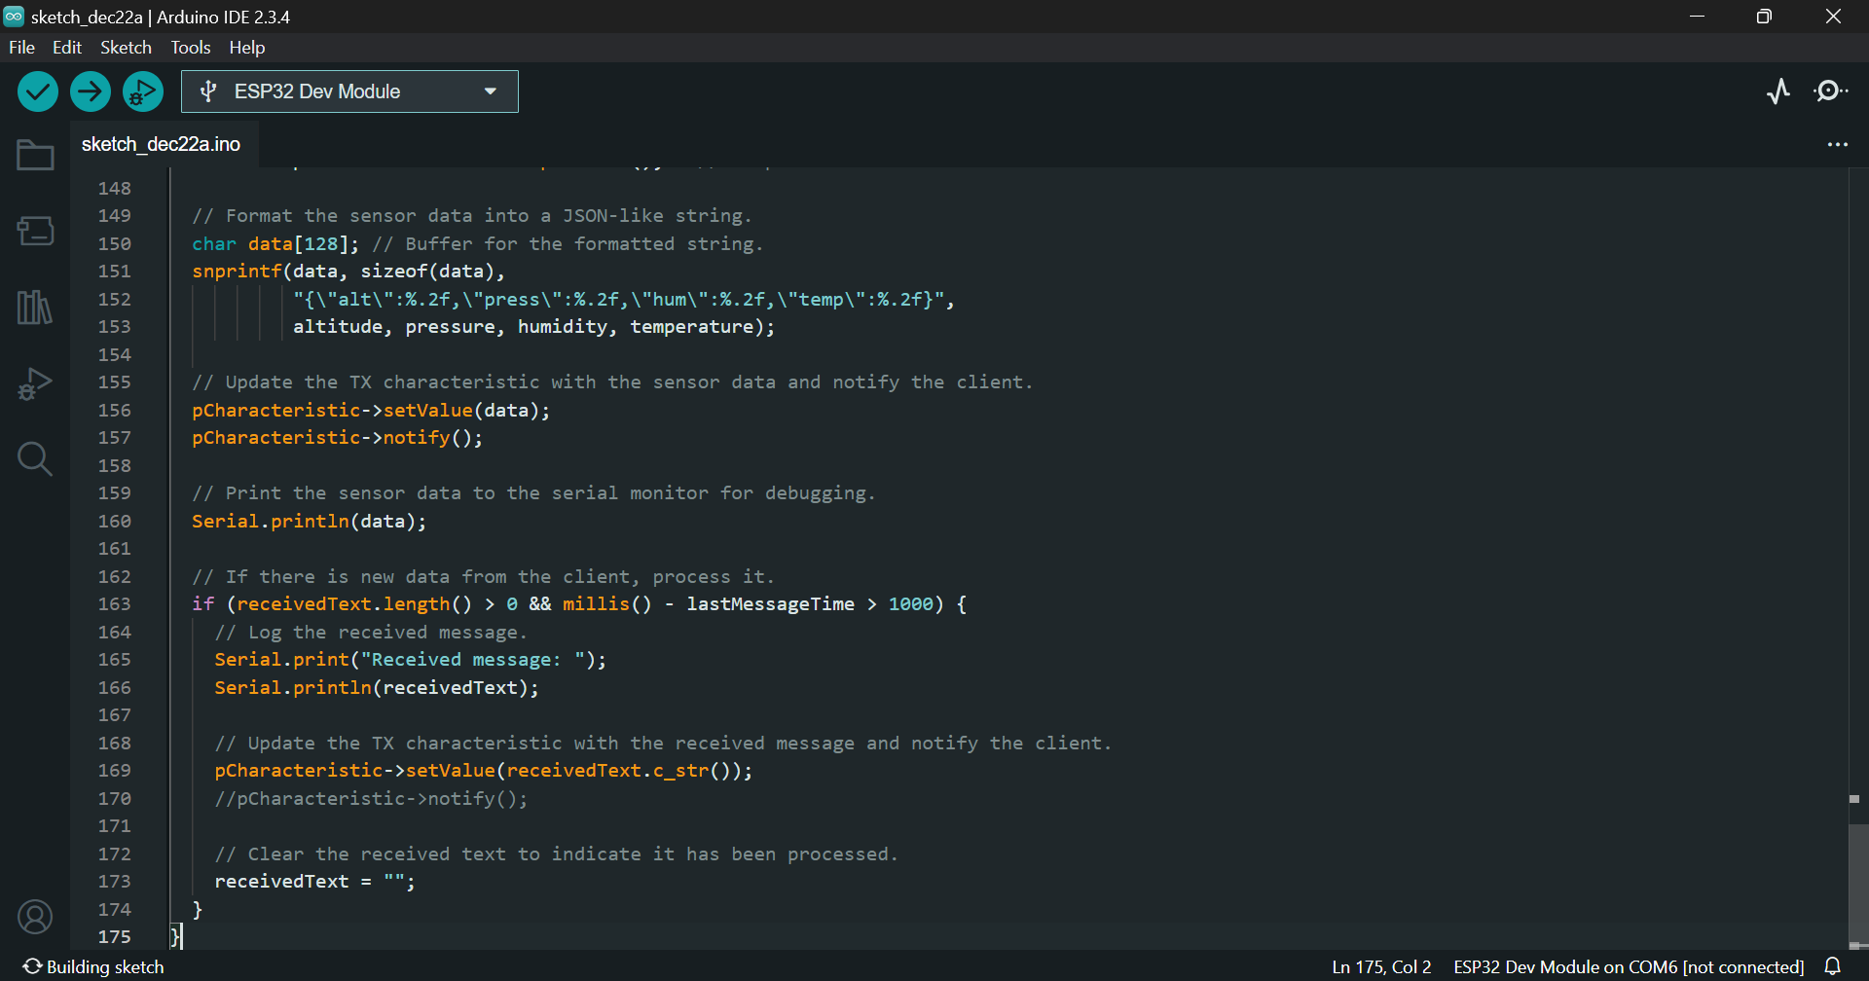
1
Paste the code in new sketch. Then, compile and upload the code to ESP32.

Slide 5
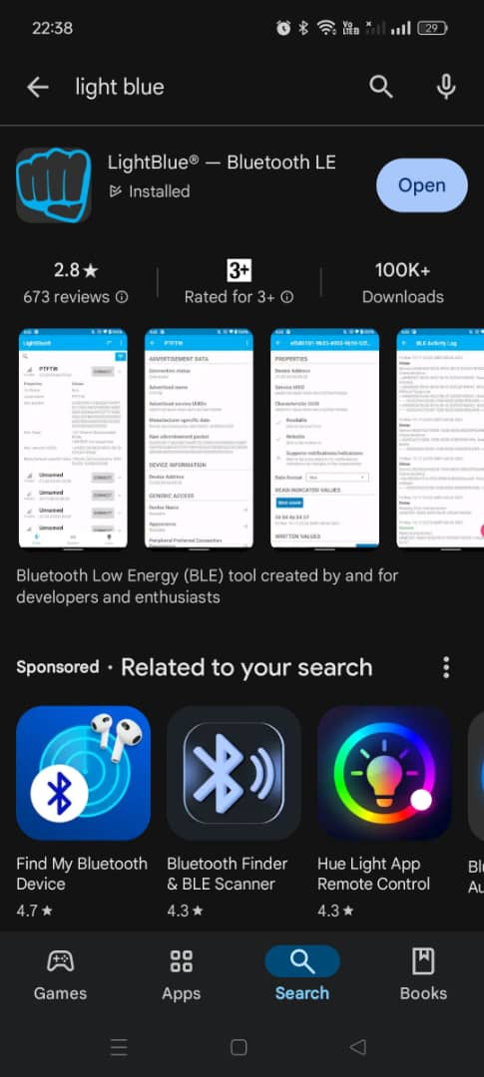
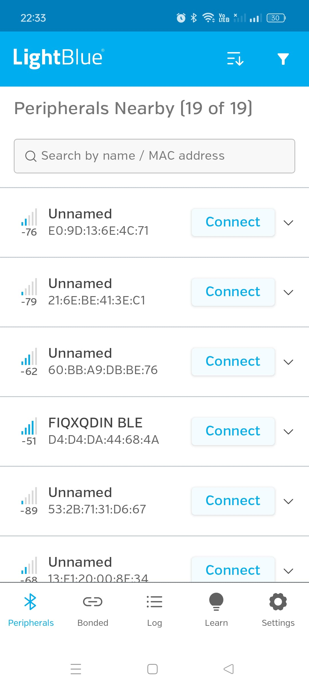
1
Install LightBlue in smartphone.
2
Open LightBlue. Then, connect with FIQXQDIN BLE.

Slide 6
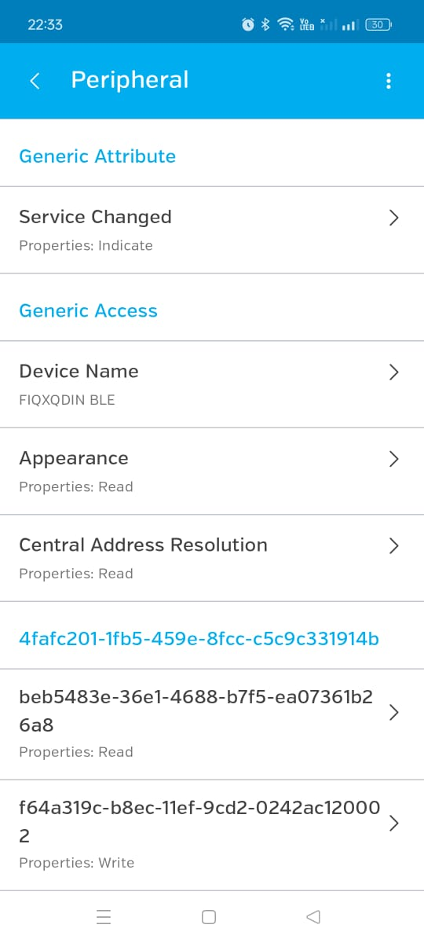
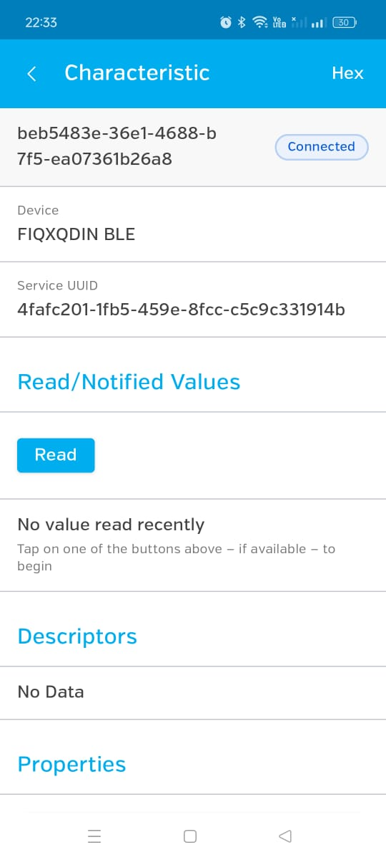
2
Then, change the output type.
1
Click the READ UUID.

Slide 7
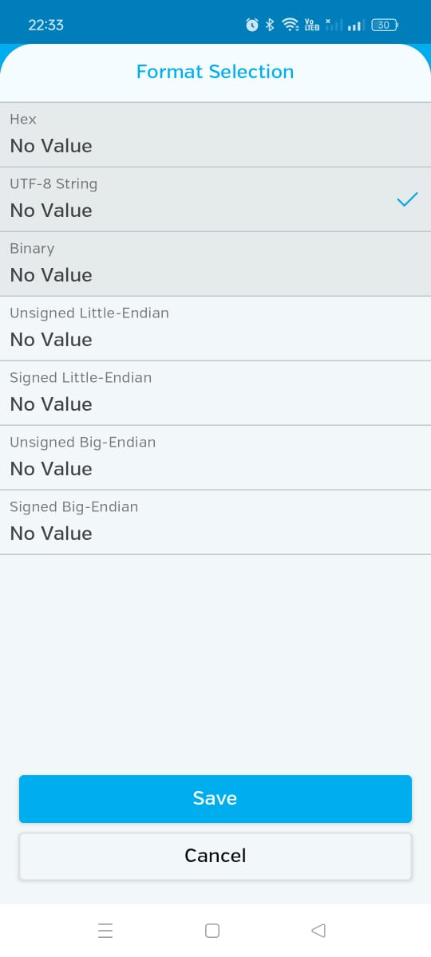
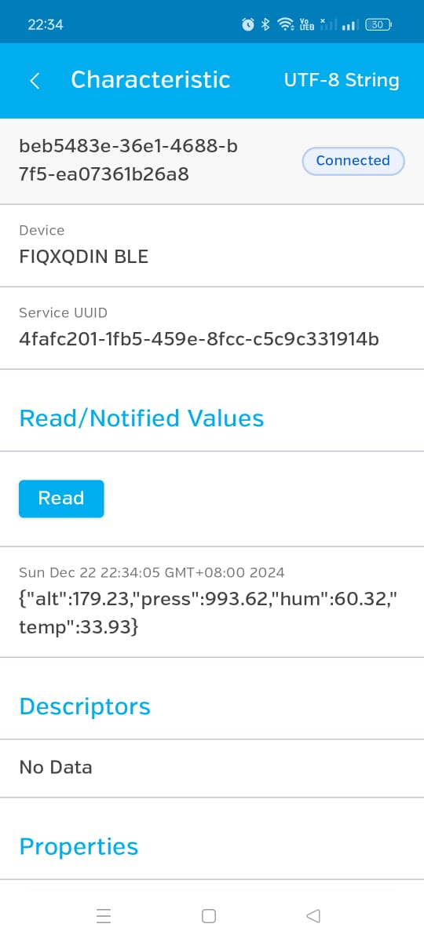
5
Click this arrow.
1
Choose string. Then, click save.
Click read. Then, below is the sensor reading.
3
4
2

Slide 8
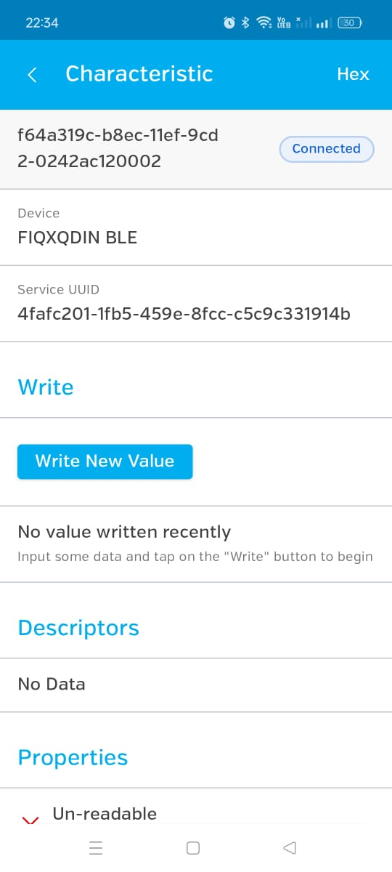
2
Change the input type.
Then, click the WRITE UUID.
1

Slide 9
1
Choose string. Then, click save.
3
Then, click write new value.
2

Slide 10
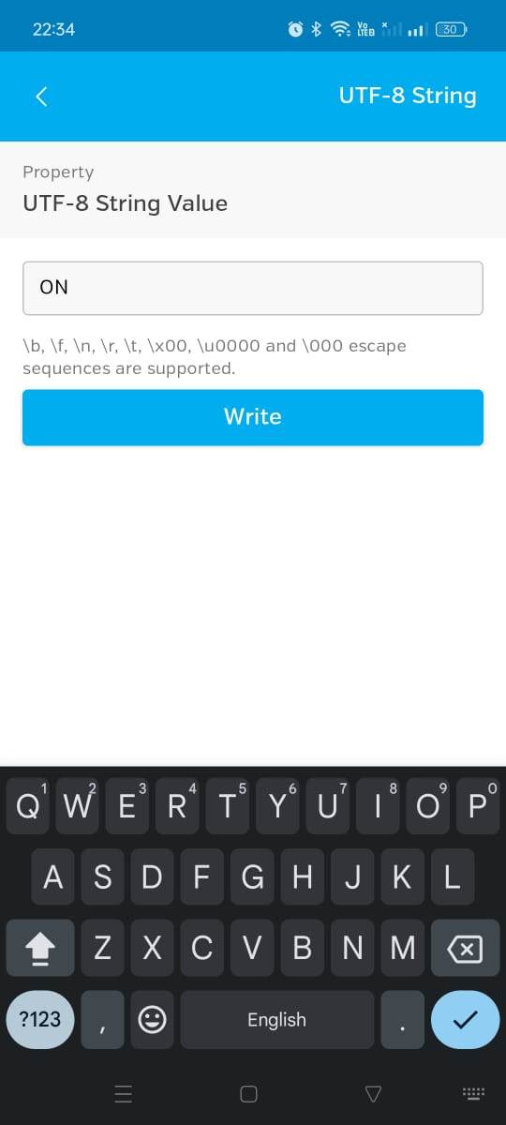
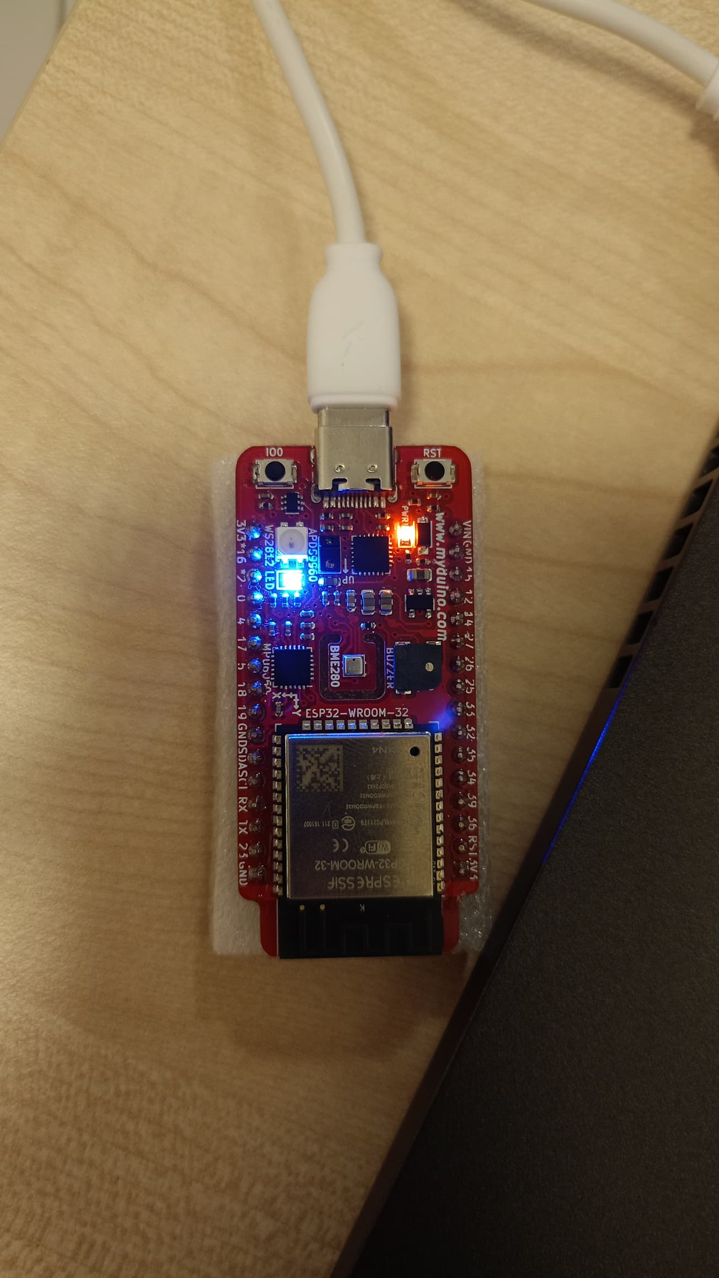
1
2
Then, insert "ON" to turn on the LED.

Slide 11
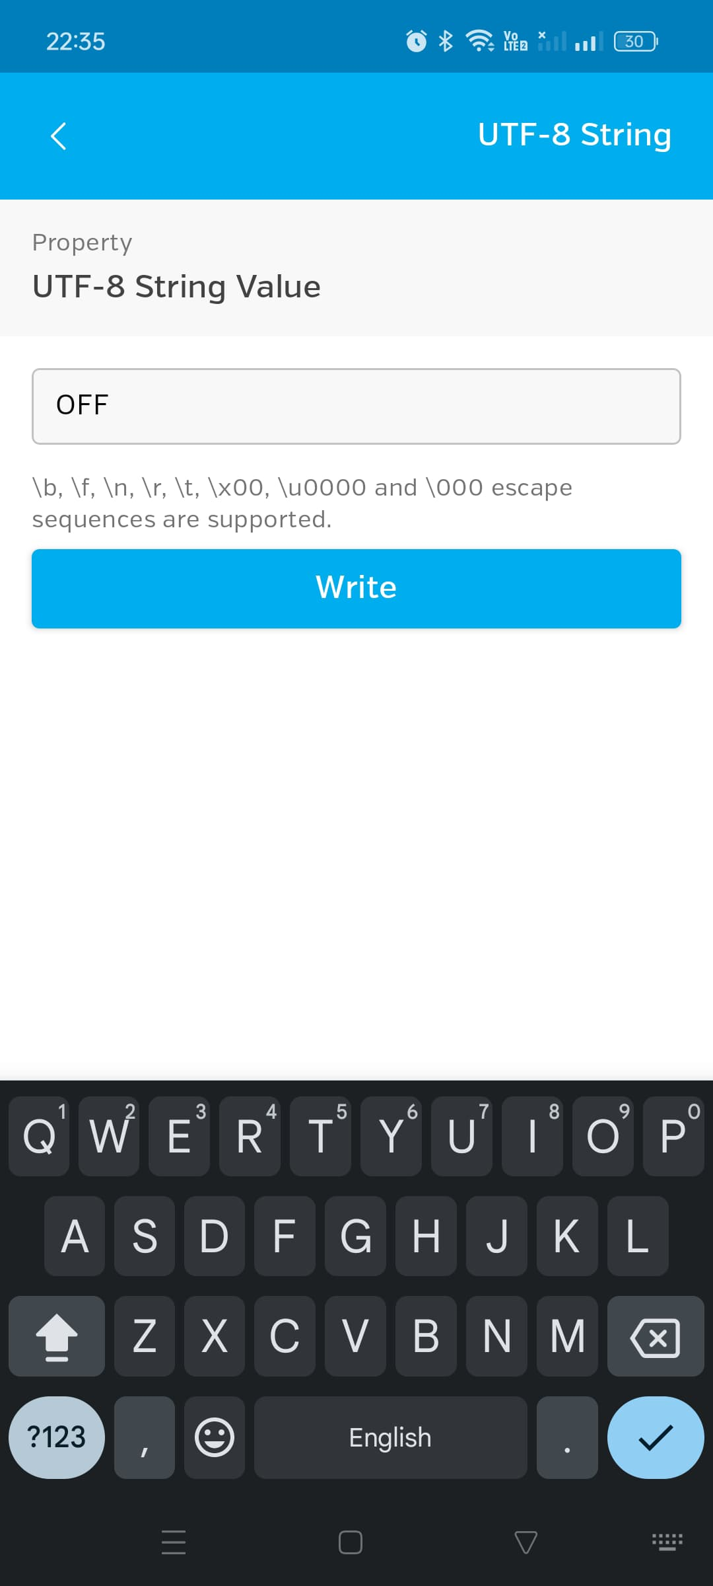
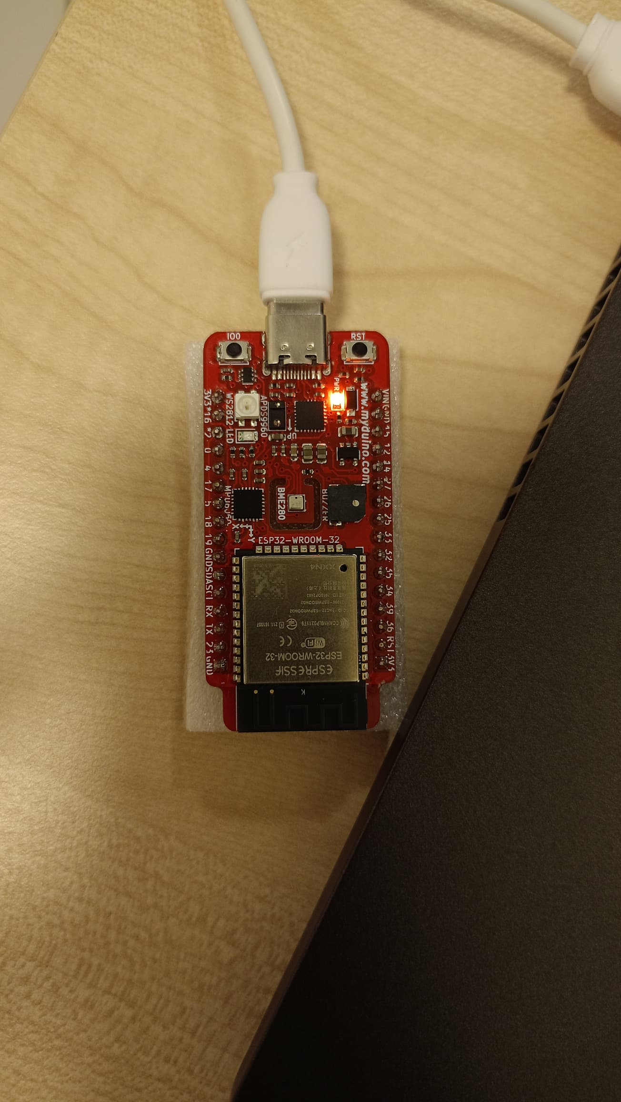
1
2
Then, insert "OFF" to turn off the LED.

